Slide 1
Object Tracking Using Python from Video
Guided By
Presented By

Slide 2
Synopsis
Objective
Introduction
Existing methods
Proposing model
System Architecture
Algorithm
Sample Input
References

Slide 3
Objective
In this project using python and OPENCV module we are detecting objects from videos and webcam. This application consists of two modules such as ‘Browse System Videos’ and ‘Start Webcam Video Tracking’.

Slide 4
Introduction
Many problems in computer vision were saturating on their accuracy before a decade.
However, with the rise of deep learning techniques, the accuracy of these problems drastically improved.
One of the major problem was that of image classification, which is defined as predicting the class of the image.
There is no object detection in existing system by using Opencv

Slide 5
Literature Survey
[1] Wei Liu and Alexander C. Berg, “SSD: Single Shot MultiBox Detector”,
Google Inc., Dec 2016.
[2] Andrew G. Howard, and Hartwig Adam, “MobileNets: Efficient
Convolutional Neural Networks for Mobile Vision Applications”, Google
Inc., 17 Apr 2017.
[3] Justin Lai, Sydney Maples, “Ammunition Detection: Developing a Real-
Time Gun Detection Classifier”, Stanford University, Feb 2017

Slide 6
Existing System
Deep learning has gained a tremendous influence on how the world is adapting to Artificial Intelligence since past few years. Some of the popular object detection algorithms are Region-based Convolutional Neural Networks (RCNN), Faster- RCNN, Single Shot Detector (SSD) and You Only Look Once (YOLO).

Slide 7
Proposing model
Dense Optical flow: These algorithms help estimate the motion vector of every pixel in a video frame.
Sparse optical flow: These algorithms, like the Kanade-Lucas-Tomashi (KLT) feature tracker, track the location of a few feature points in an image.
Kalman Filtering: A very popular signal processing algorithm used to predict the location of a moving object based on prior motion information. One of the early applications of this algorithm was missile guidance! Also as mentioned here, “the on-board computer that guided the descent of the Apollo 11 lunar module to the moon had a Kalman filter”.

Slide 8
Modules
Browse System Videos: Using this module application allow user to upload any video from his system and application will connect to that video and start playing it, while playing if application detect any object then it will mark that object with bounding boxes, while playing video if user wants to stop tracking then he need to press ‘q’ key from keyboard to stop video playing.

Slide 9
Start Webcam Video Tracking: Using this module application connect itself with inbuilt system webcam and start video streaming, while streaming if application detect any object then it will surround that object with bounding boxes, while playing press ‘q’ to stop web cam streaming.

Slide 10
UML

Slide 13
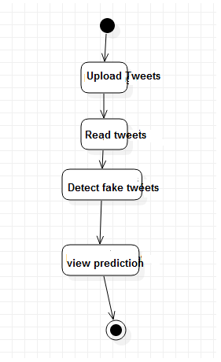

Slide 14
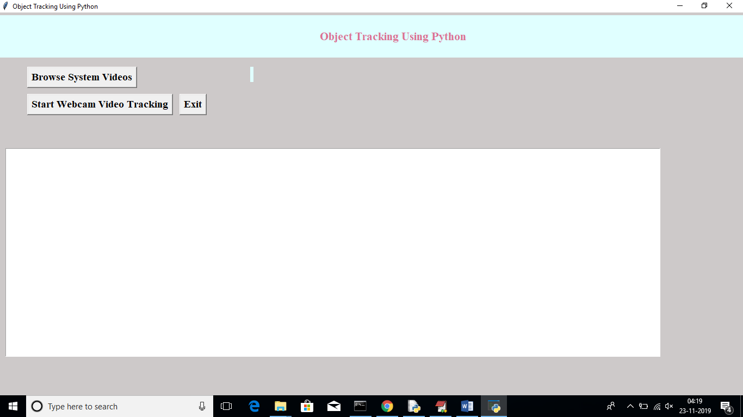
Screen Shots

Slide 15
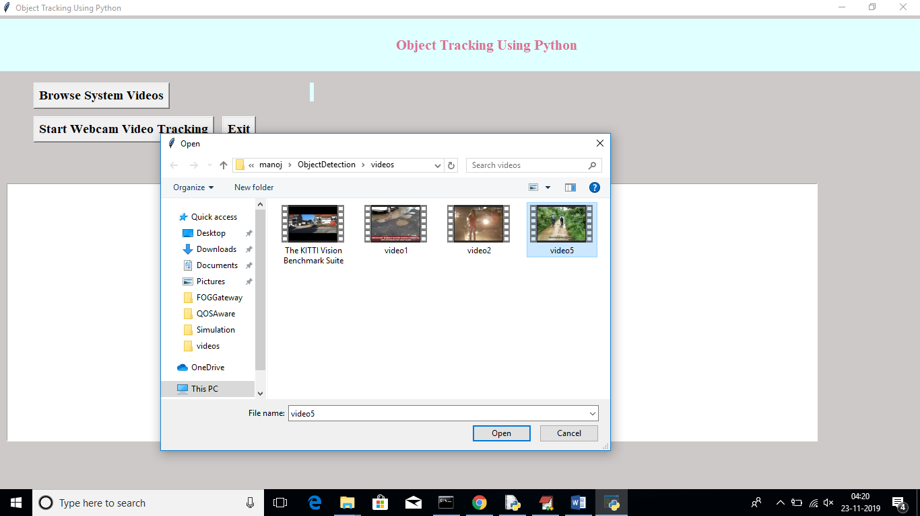

Slide 16
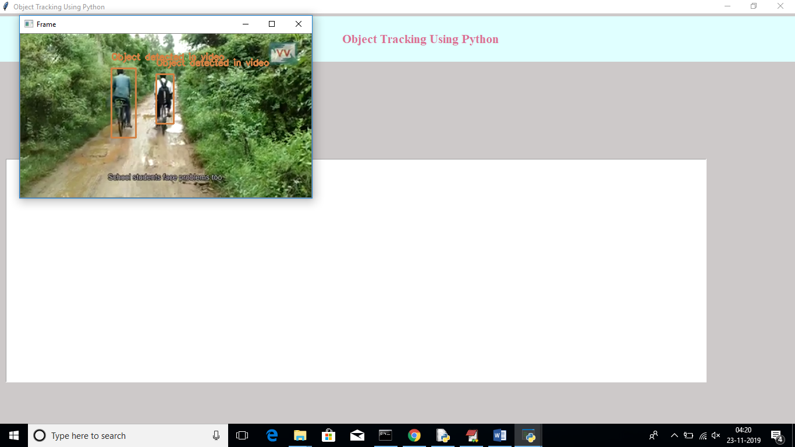

Slide 17
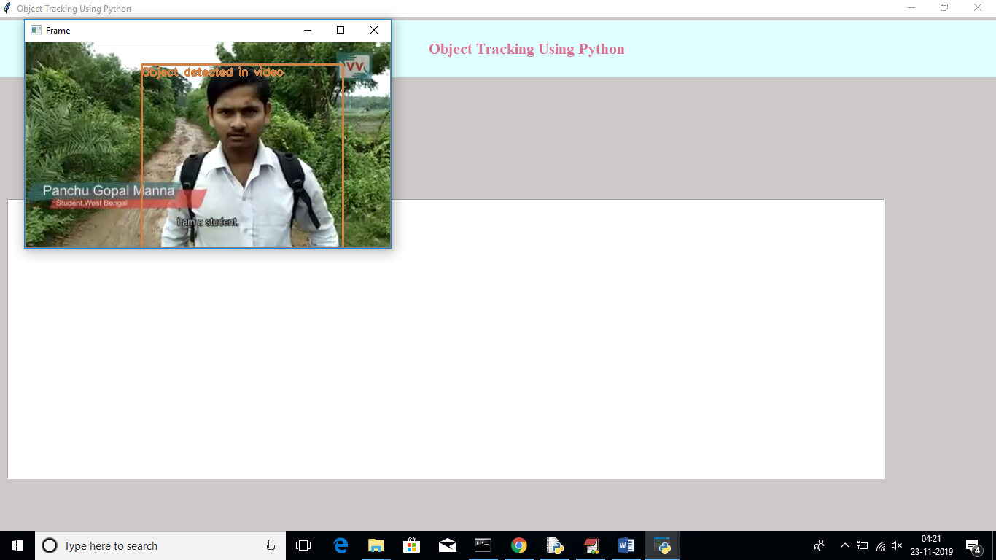

Slide 18
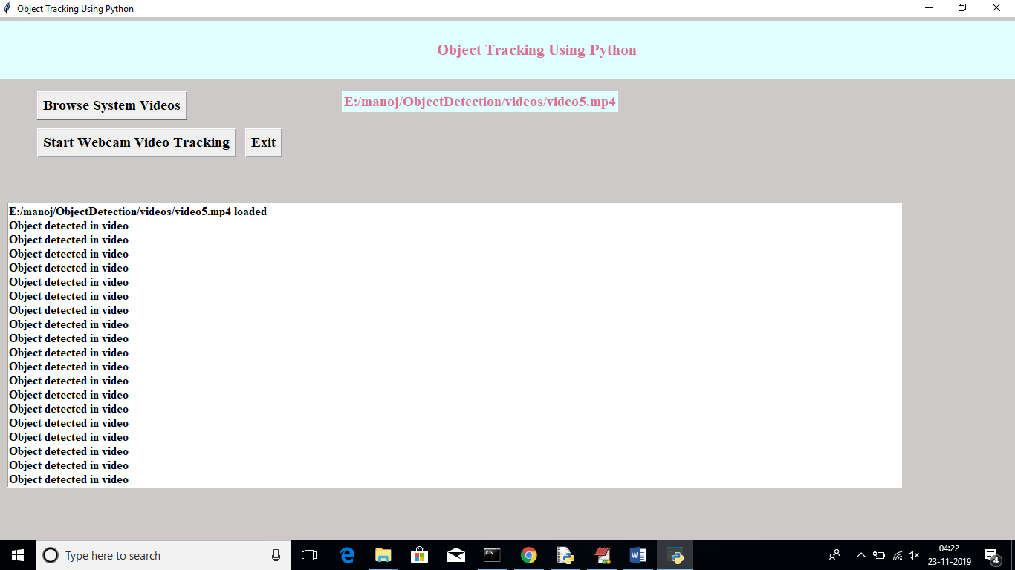

Slide 19
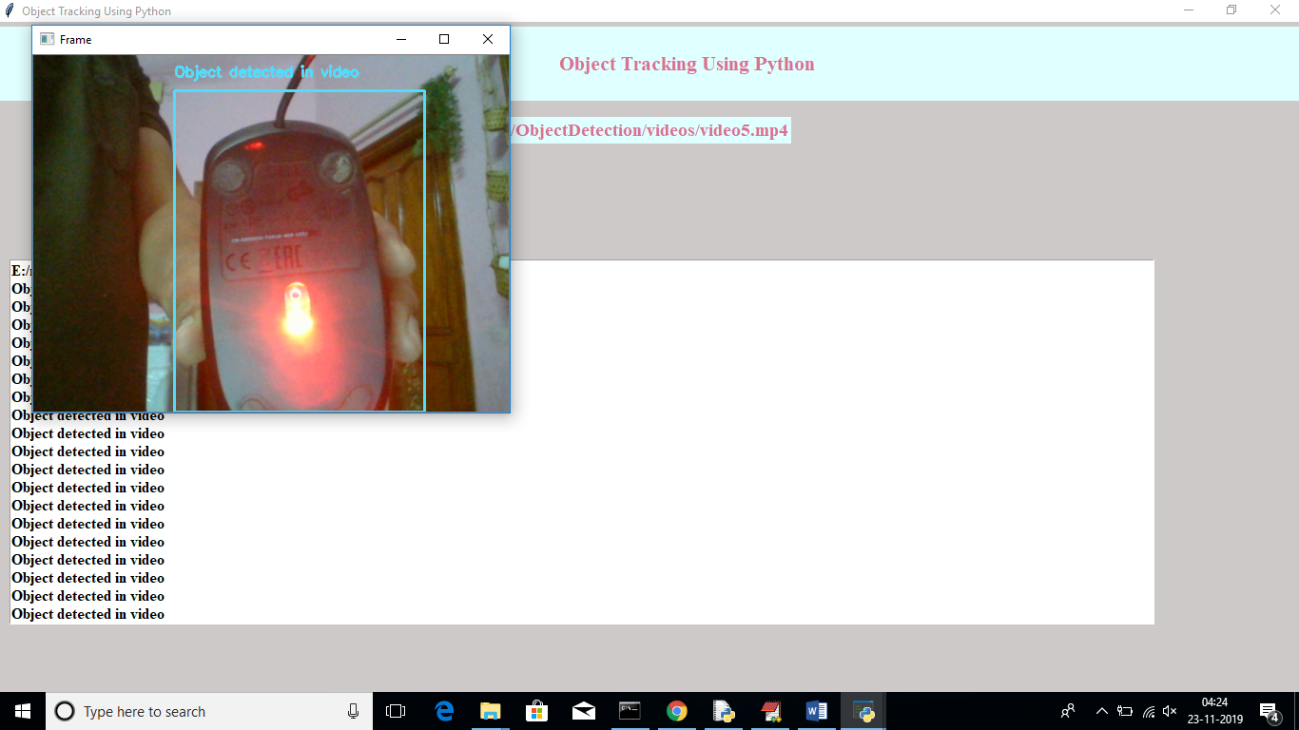

Slide 20
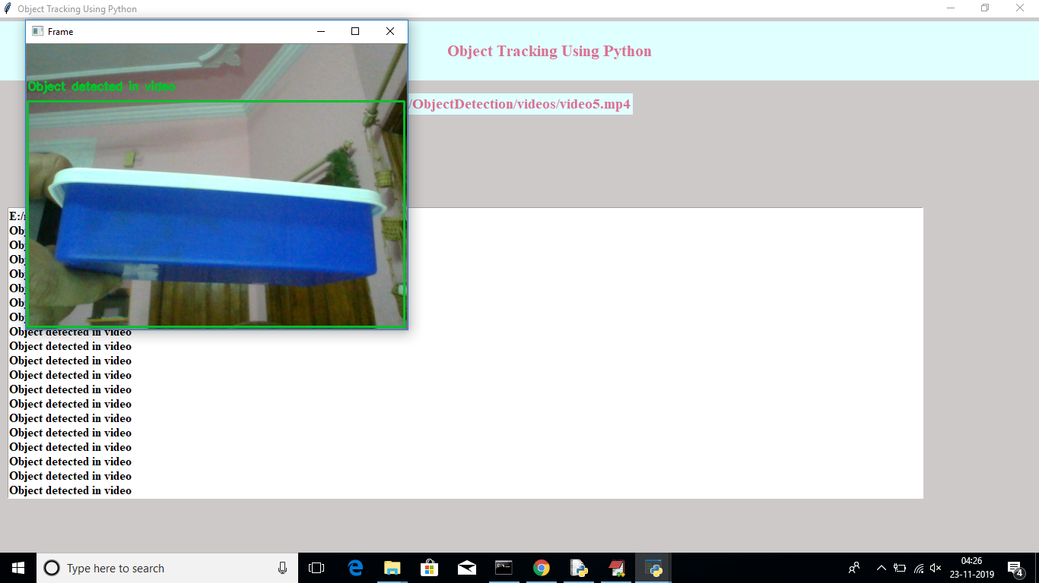

Slide 21
CONCLUSION
An accurate and efficient object detection system has been developed which achieves comparable metrics with the existing state-of-the-art system. This project uses recent techniques in the field of computer vision and deep learning.

Slide 22
References
[1] Wei Liu and Alexander C. Berg, “SSD: Single Shot MultiBox Detector”,
Google Inc., Dec 2016.
[2] Andrew G. Howard, and Hartwig Adam, “MobileNets: Efficient
Convolutional Neural Networks for Mobile Vision Applications”, Google
Inc., 17 Apr 2017.
[3] Justin Lai, Sydney Maples, “Ammunition Detection: Developing a Real-
Time Gun Detection Classifier”, Stanford University, Feb 2017

Slide 23
[4] Shreyamsh Kamate, “UAV: Application of Object Detection and
Tracking Techniques for Unmanned Aerial Vehicles”, Texas A&M
University, 2015.
[5] Adrian Rosebrock, “Object detection with deep learning and OpenCV”,
pyimagesearch.
[6] Mohana and H. V. R. Aradhya, "Elegant and efficient algorithms for real
time object detection, counting and classification for video surveillance
applications from single fixed camera," 2016 International Conference
on Circuits, Controls, Communications and Computing (I4C),
Bangalore, 2016, pp. 1-7.

Slide 24
Thank you

